Slide 1
Zooniverse Type II Catalog
Xander Hall

Slide 2
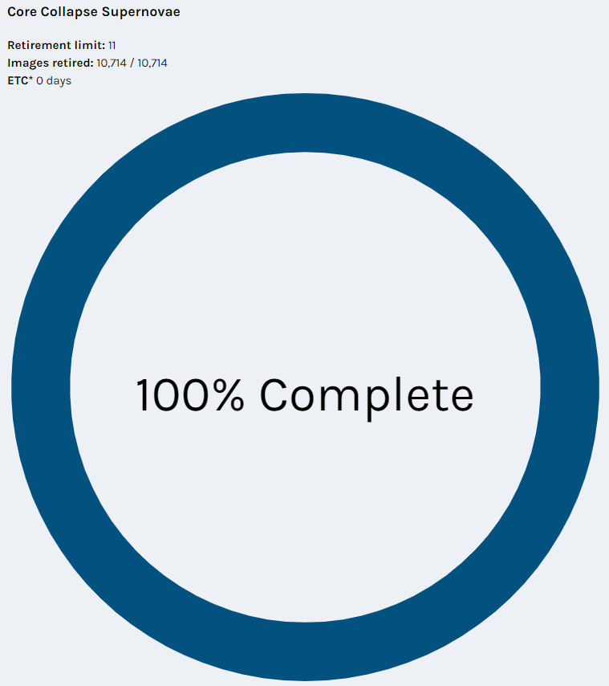
Achieved
Using the Zooniverse we have classified 10,714 spectrum.
This was achieved in ~160 Days
This means that we received about ~730 classification per day
Each spectrum was reviewed by 11 different volunteers

Slide 3
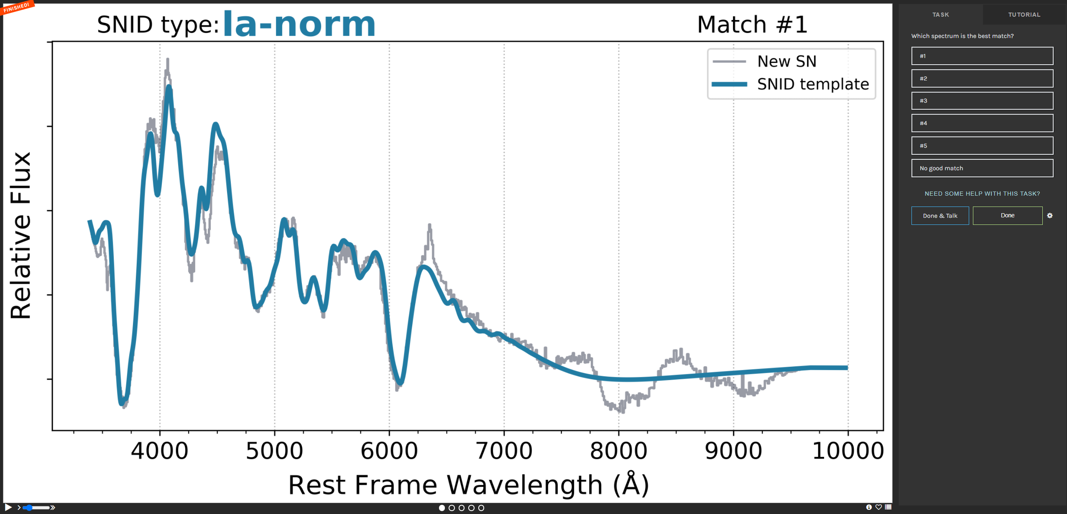
Process
Run every spectrum through SNID.
Graph the template results of the “top 5” matches.
Let volunteers decide the best match.
Run Superfit on the spectrum.
If Superfit and 6 volunteers agree it is a Type II we can confidently say it is a Type II

Slide 4
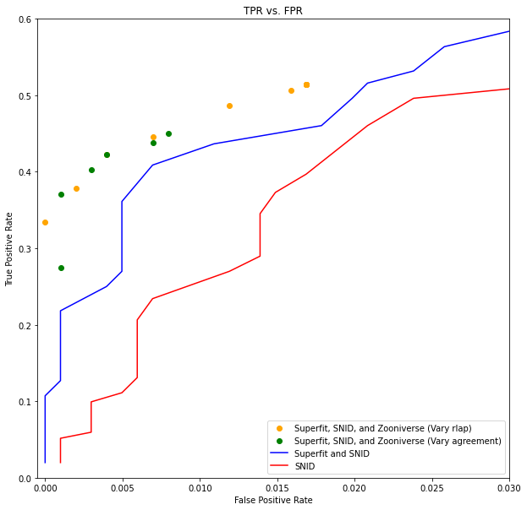
Results
Using ~700 SNe from the first RCF paper we can conclude that we achieve ~50% TPR at a 0.5% FPR.
This means we found ~385 Type II SNe
The Volunteers and Superfit perform about 10% better than just SNID and Superfit alone.
This all done if just one of the spectrum received is classified as a Type II

Slide 5
In Progress
Build an automated bot.
Take a new spectrum from the Marshall.
Run this through SNID and Superfit.
Upload the SNID templates to Zooniverse.
Download the Zooniverse classifications.
If it passes the requirements upload a classification to TNS as a Type II.
Release a paper listing these classification and the process.

